Slide 1


Financial Analysis
Introduction
The Financial Analysis Database project is designed to provide comprehensive insights into customer and branch financial activities within a fictional banking system using SQL. The project encompasses the creation and management of a relational database that stores detailed information about customers, branches, accounts, and transactions. This database serves as a robust foundation for analyzing financial trends, customer behavior, and branch performance.

Slide 2
TASK GOALS
01
Identifying customers residing in specific cities with Relevant
Information
Customer Information
Account Analysis
02
Counting the total number of accounts and calculating the total balance of checking accounts.
03
Identifying branches with the highest average account balance and the total balance across all accounts.
Branch Performance
Transaction Analysis
04
Determining which branch has the highest number of transactions.

Slide 3
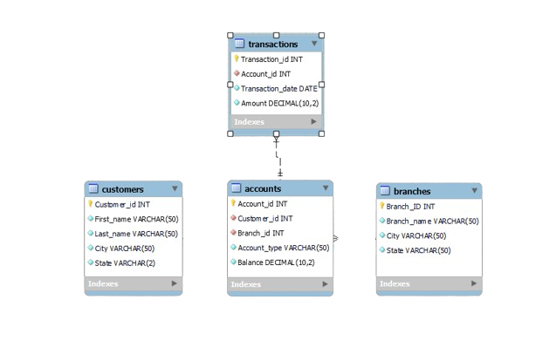
SCHEMA DIAGRAM
Input 2

Slide 4


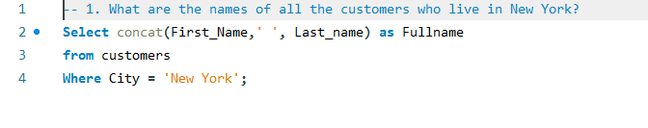
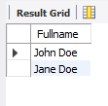

IDENTIFYING CUSTOMERS LIVING IN ‘NEW YORK’

Slide 5
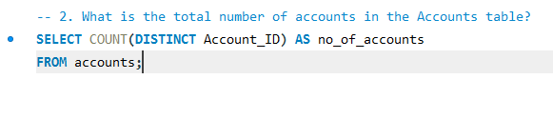
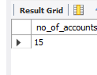

TOTAL NUMBER OF ‘UNIQUE ACCOUNTS’

Slide 6

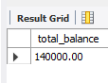

‘TOTAL BALANCE’ IN THE ACCOUNTS

Slide 7
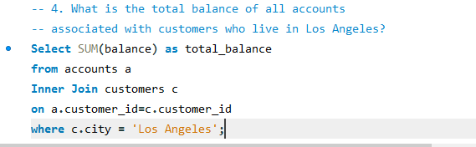
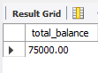
TOTAL BALANCE OF ‘LOS ANGELES CUSTOMERS’

Slide 8
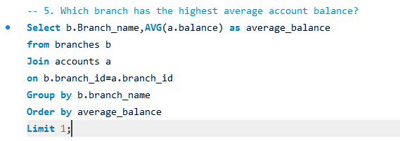
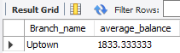
BRANCH WITH ‘HIGHEST AVERAGE BALANCE’

Slide 9
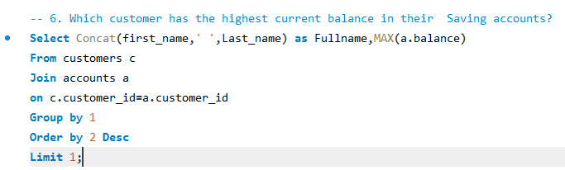
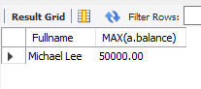
CUSTOMER WITH ‘HIGHEST BALANCE‘

Slide 10
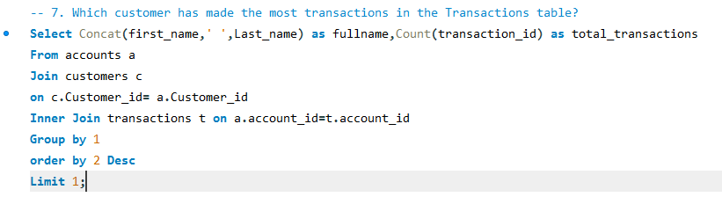
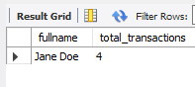
CUSTOMER WITH ‘MOST TRANSACTIONS‘

Slide 11
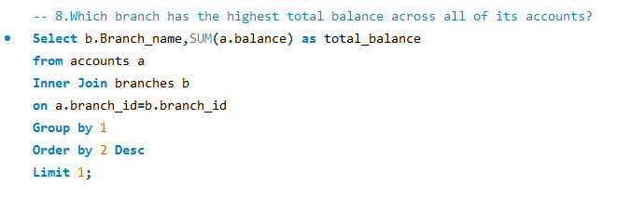
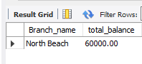
BRANCH WITH ‘HIGHEST TOTAL BALANCE’

Slide 12
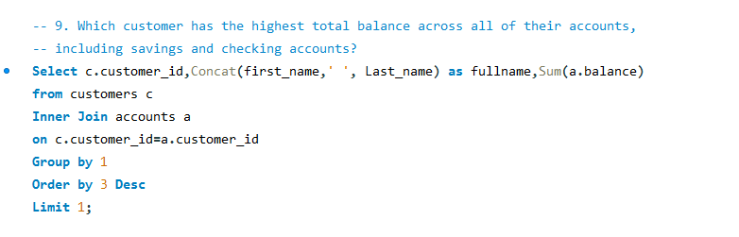
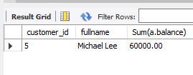
CUSTOMER WITH ‘HIGHEST TOTAL BALANCE’

Slide 13
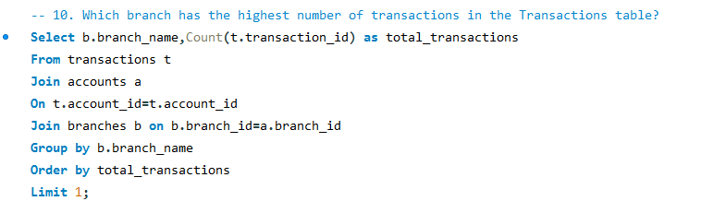
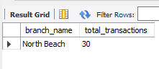
BRANCH WITH ‘MOST TRANSACTIONS’

Slide 14




THANK YOU
Linkedin
www.linkedin.com/in/snehnamdev

